Slide 1
India tackles the COVID-19 outbreak effectively

Slide 3
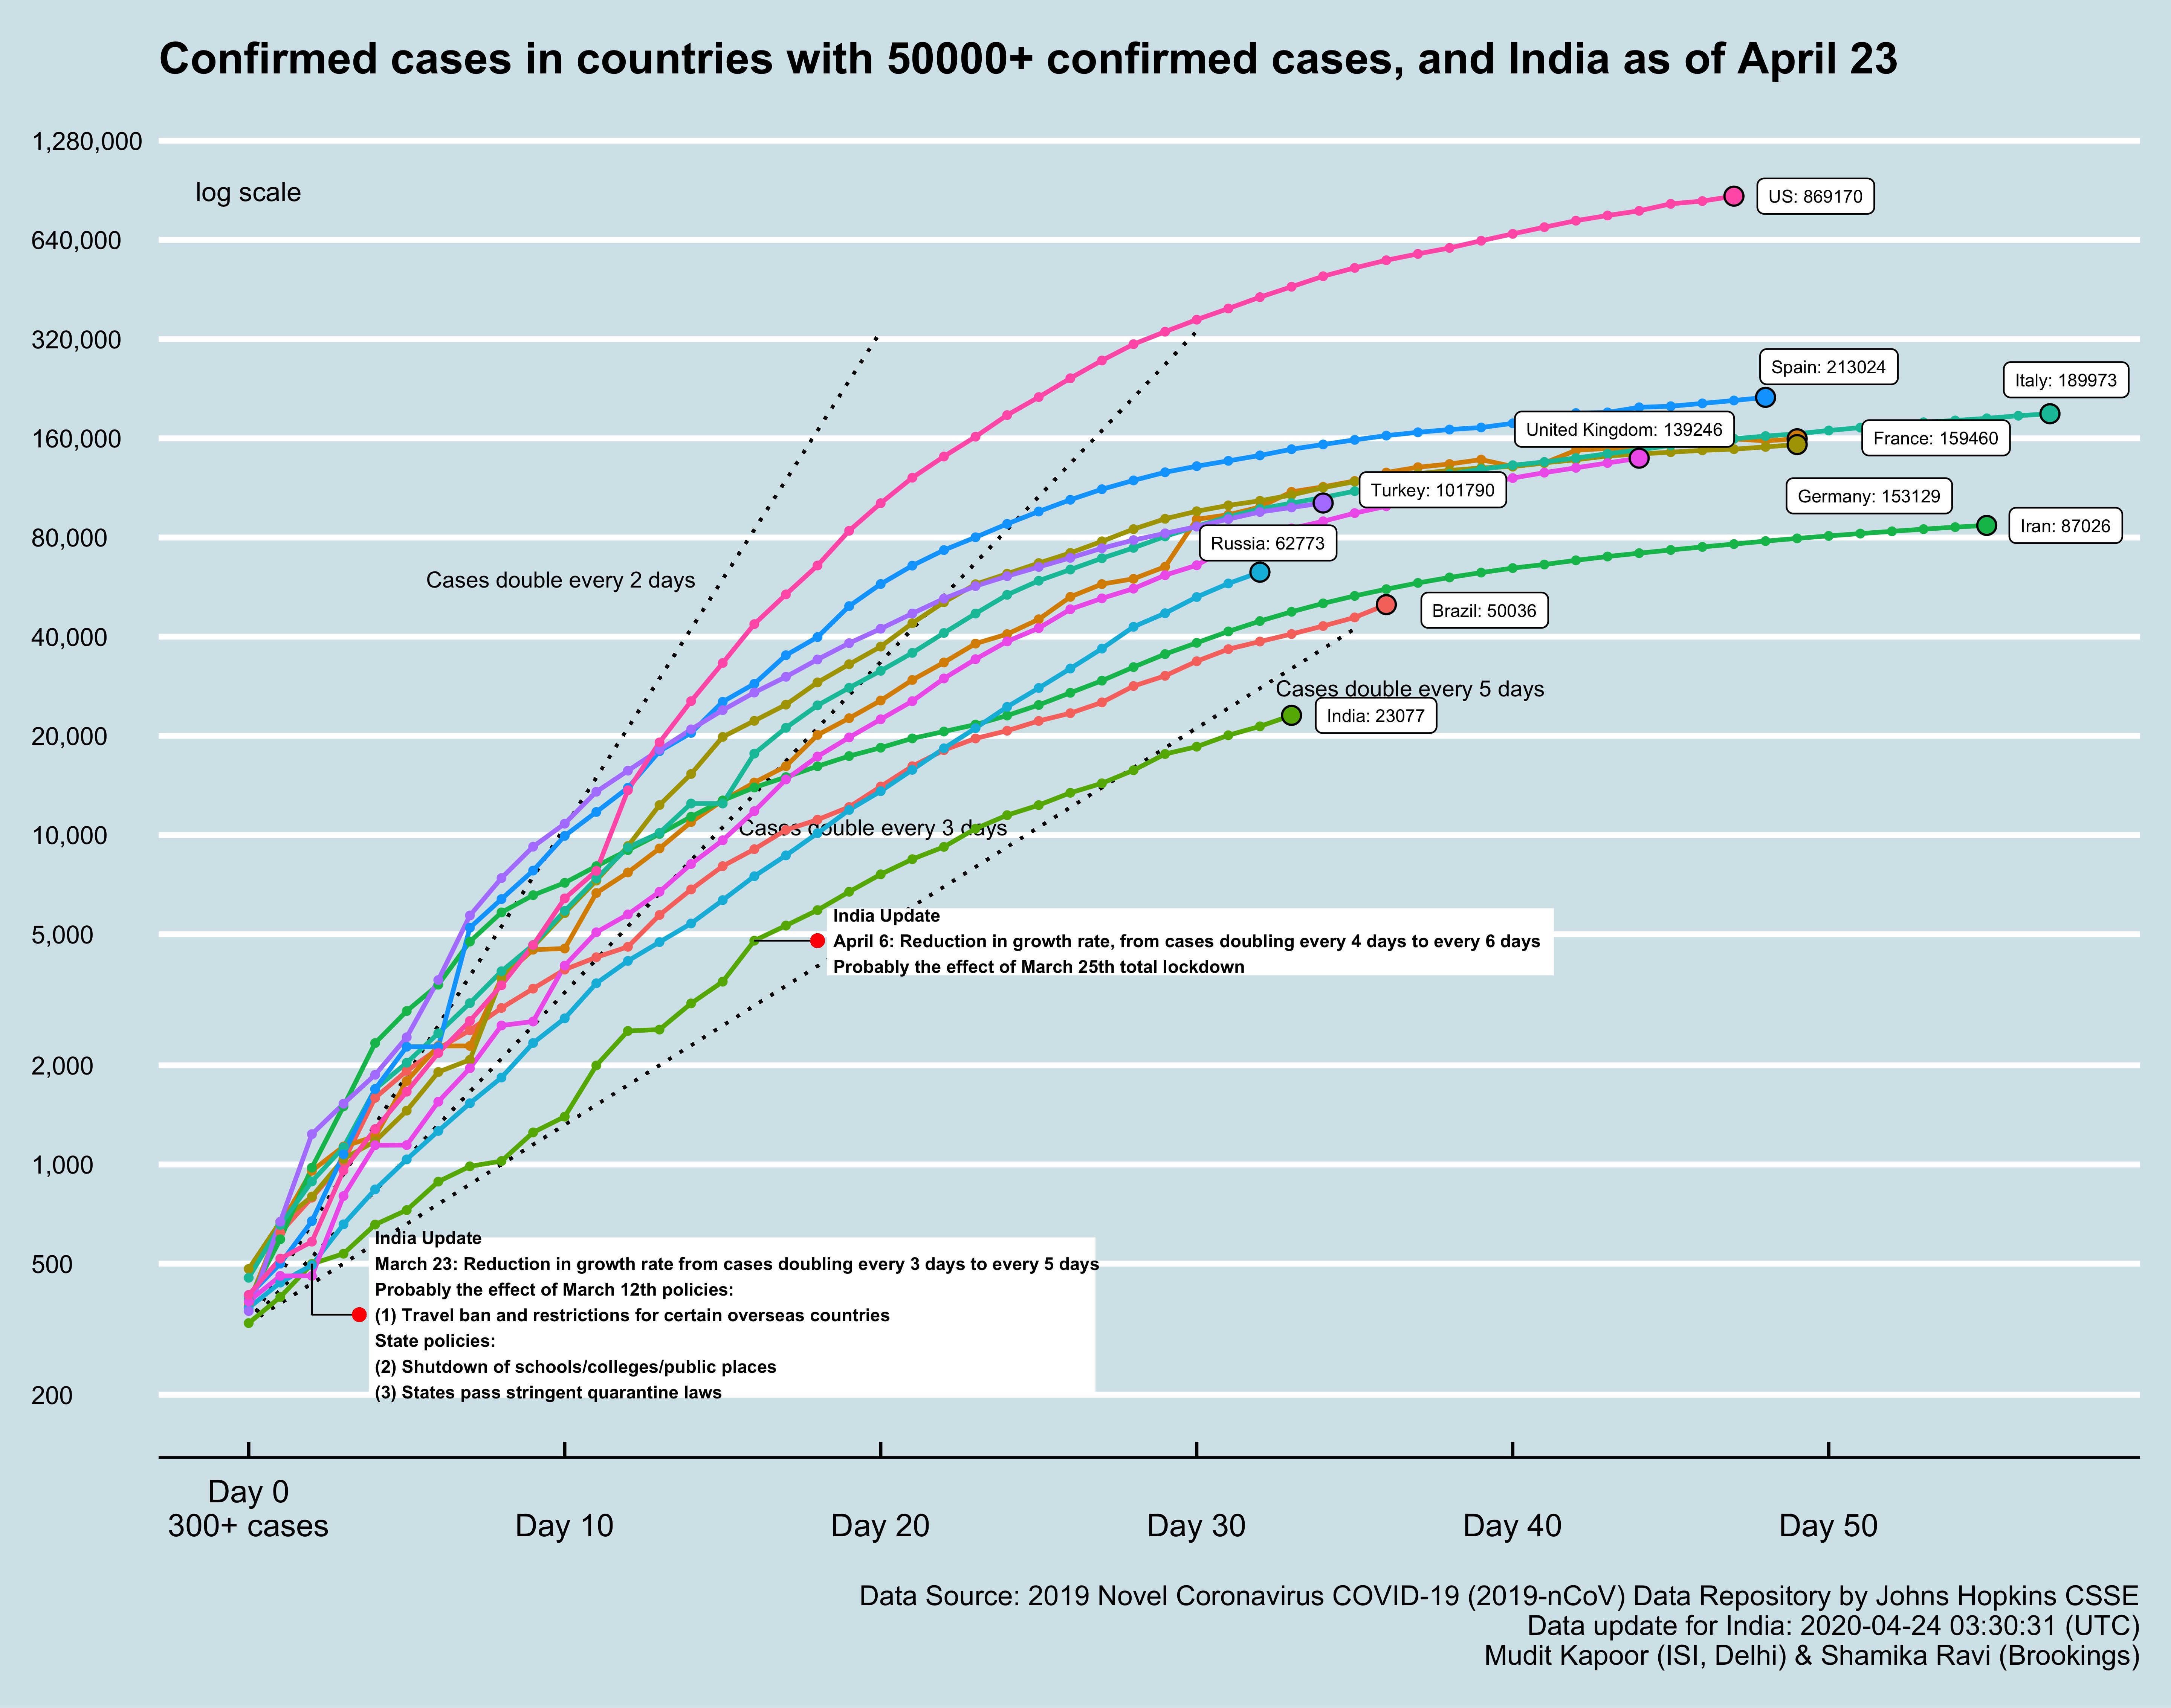
India: March 21

Slide 4
Projections vs Actual from 25th March, 2020
Courtesy: Kapoor M, R Shamika

Slide 6
K Madan Gopal

Slide 7
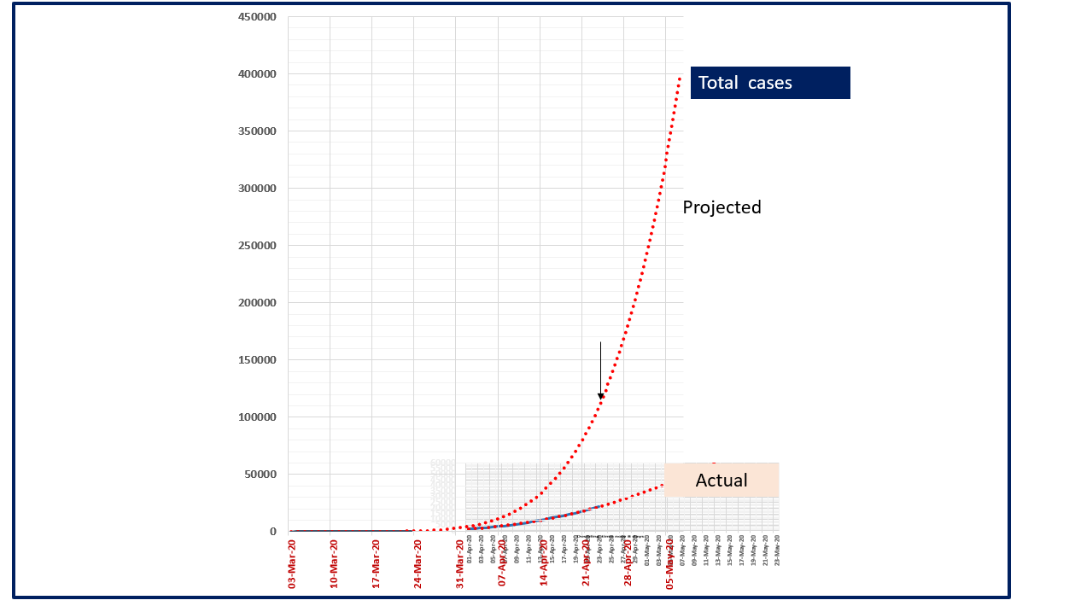

Slide 8
New, Cumulative Cases, Doubling Rate: COVID 19 - India
As on 23.4.2020
Burden: 17.1/1M
Doubling Rate on Moving avr. 3 days
Cumulative cases
New cases/day
Ramji S

Slide 9
Thank you

